Slide 1
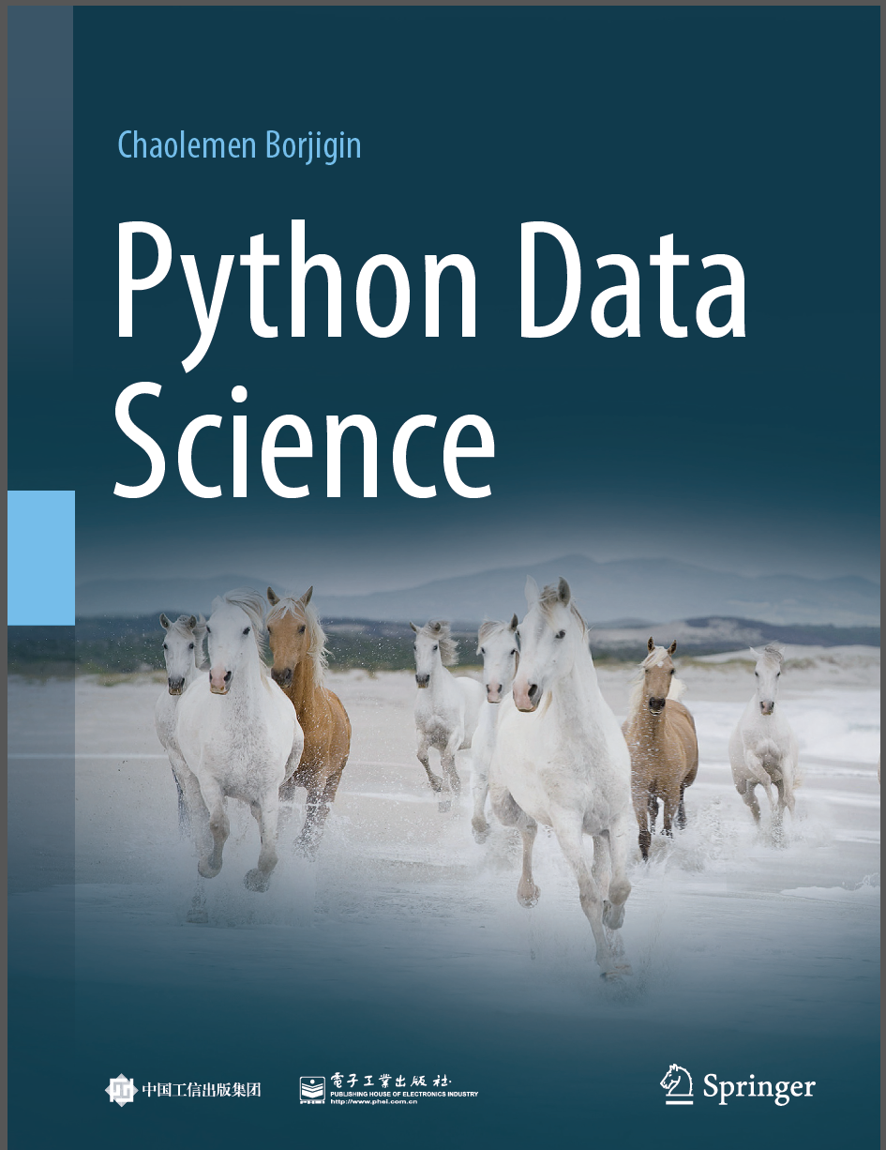
Python Data Science
Chaolemen Borjigin
Renmin University of China
chaolemen@ruc.edu.cn

Slide 2
3.3 Packages
▼ Chapter 3 Advanced Python Programming for Data Science
► 3.3 Packages
Chaolemen Borjigin
Renmin University of China
chaolemen@ruc.edu.cn

Slide 3
Summary of this chapter
▼ Chapter 3 Advanced Python Programming for Data Science
► 3.3 Packages
3.3.1 Packages vs modules
3.3.2 Installing packages
3.3.3 Checking installed packages
3.3.4 Updating or removing installed packages
3.3.5 Importing packages or modules
3.3.6 Checking Package Version
3.3.7 Commonly used Packages

Slide 4
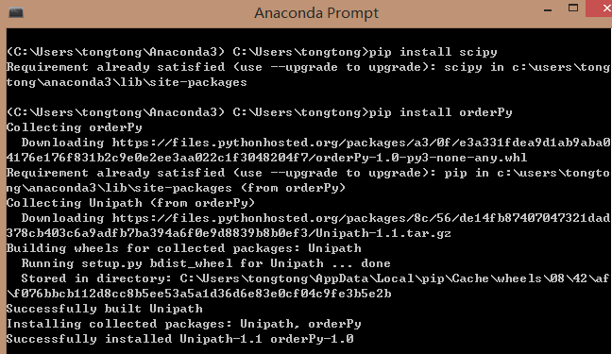
3.3.2 Installing packages
▼Chapter 3 Advanced Python Programming for Data Science
► 3.3 Packages
In[2]:
# pip list package_name
# conda list package_name

Slide 5
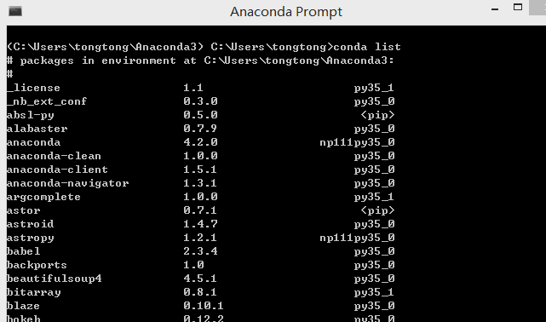
3.3.3 Checking installed packages
▼Chapter 3 Advanced Python Programming for Data Science
► 3.3 Packages
In[3]:
# pip list
# conda list

Slide 6
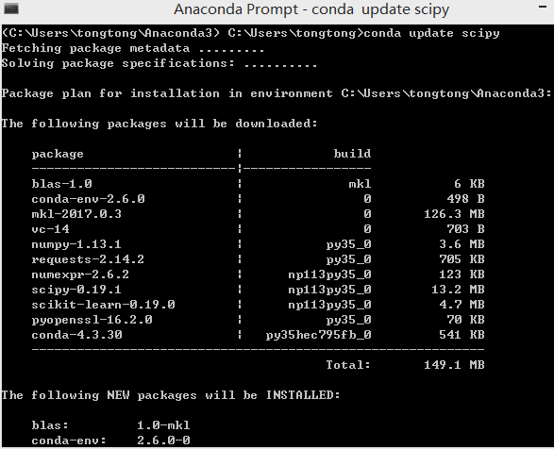
3.3.4 Updating or removing installed packages
▼Chapter 3 Advanced Python Programming for Data Science
► 3.3 Packages
In[4]:
#pip install --upgrade a package's name
#conda update a package's name

Slide 7
3.3.5 Importing packages or modules
▼Chapter 3 Advanced Python Programming for Data Science
► 3.3 Packages
In[5]:
import pandas as pd
import pandas as pd, numpy as np, math as math
from pandas import DataFrame
import Graphics.Primitive.fill

Slide 8
3.3.6 Checking Package Version
▼Chapter 3 Advanced Python Programming for Data Science
► 3.3 Packages
In[6]:
pd.__version__
Out[6]:
'0.22.0'

Slide 9


